Slide 1


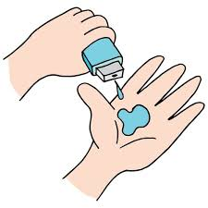
IBM SKILLS BUILD
Edunet
foundation
CYBER SECURITY IN
PASWORDLESS
AUTHENTICATION

Slide 2
PPASSWORDLESS AUTHENTICATION
Passwordless authentication is an authentication method in which a user can log in to a computer system or mobile phone without the entering a password or any other knowledge-based secret.
96% say passwordless authentication would create an easier user experience (UX) for employees;
Common types of passwordless authentication include email-based, SMS-based, multi-factor, biometrics or passwordless authentication for logged-in users.

Slide 3

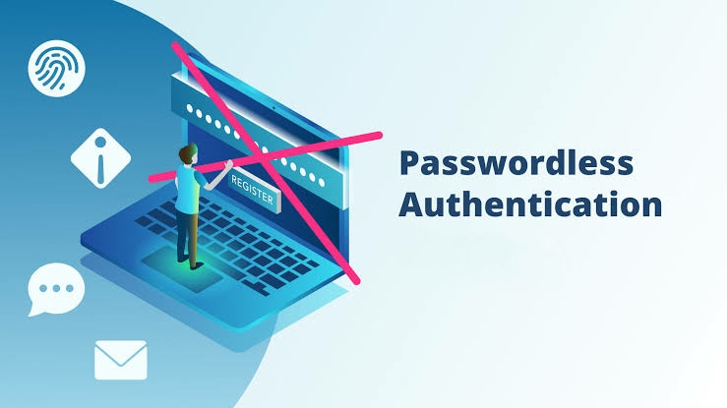
AGENDA
eliminating password and secrets fatigue, and providing unified access to all applications and services.
eliminating risky password management techniques and reducing credential theft and impersonation.
eliminating the n.eed to issue, secure, rotate, reset, and manage passwords.
Reduce the risk of hacking like phishing attacks,malware and third party access..

Slide 4

PROBLEM STATEMENT
The passwords we use today are no longer a solid barrier for attackers.
Many people tend to use the same password for multiple applications. In the event that one of the passwords is breached through phishing, leaked, or stolen, there is a high chance that cyber-attackers will gain access to multiple accounts.
They can therefore obtain confidential IP, financial, or client data. They can also spy on internal messages, commit financial fraud, gain access to a company’s network, and even divulge trade secrets.
So we use the Paswordless Athentication method.

Slide 5

PROJECT OVERVIEW
A simple website which allows user to register and login to the interface of the website.
The registration process should be of as easy as possible without asking more fields of information.The user does not need to type anyone of the pasword.
The user need to login using the otp sent to Registered mobile number.

Slide 6
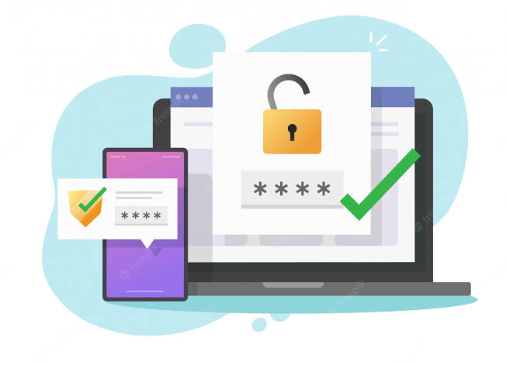

WHO ARE THE END USERS?
The admin and the user who want to use the site for uploading documents can use this database at any time.
students can acces the materials through online.
The user must be given permission after the authorization only.
Interface will be same for all the users.

Slide 7

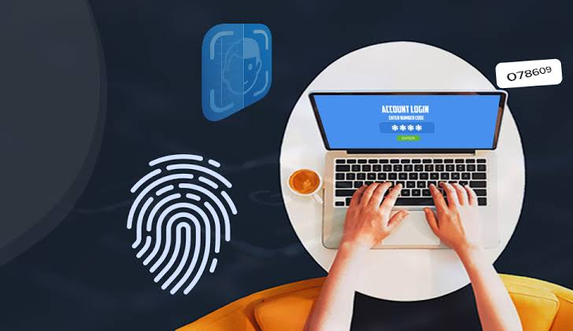
YOUR SOLUTION AND ITS VALUE PROPOSITION
The user need to enter either email adress or username
and registered mobile number .Click on submit button.
The otp will be sent to registered mobile number.
The user enters the OTP and verify.
After successfu verifcation user will allow to login to website.
A welcome dashboard appears so user can use the website and manage the user acount based upon their interest.

Slide 8


THE WOW IN YOUR SOLUTION
We have numerous ways to select paswordlessauthentication.Here I am using the OTP to the mobile phone to login to the site.
. This allows the user without remembering the paswords and secure way of login to the site.
In the registration process user need to give:
Username
Email Adress
Phone Number
In login process user need to give:
Usernamee or email
Mobile number
OTP Verification

Slide 9
MODELING
Login Screen User Flow
Login Screen
Website
Existing User
Login
Yes
No
Login
Registration Form
New user

Slide 10
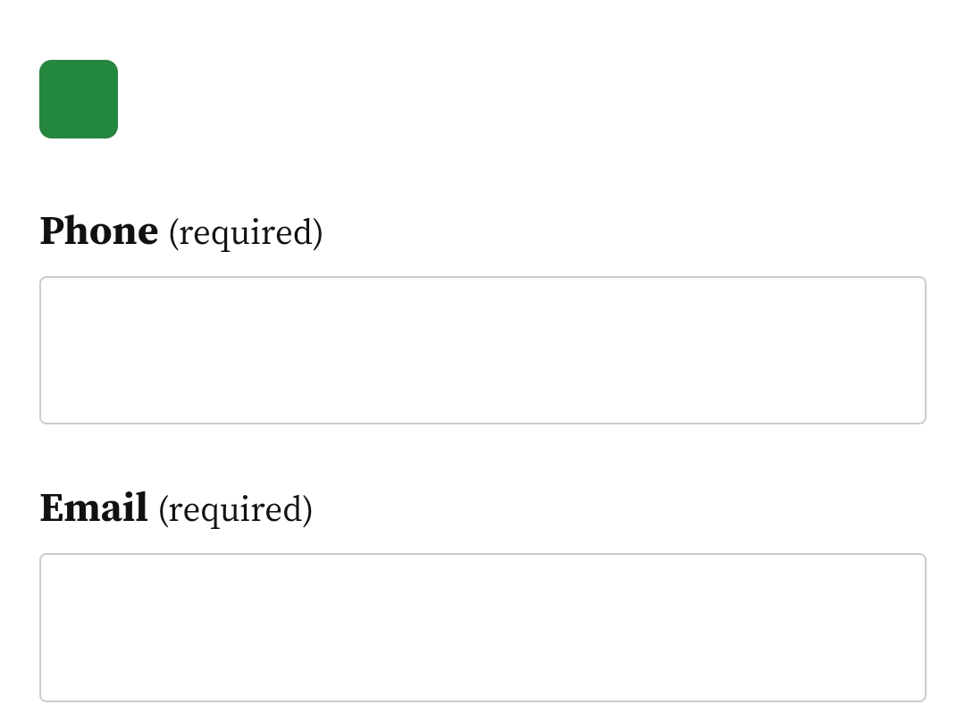
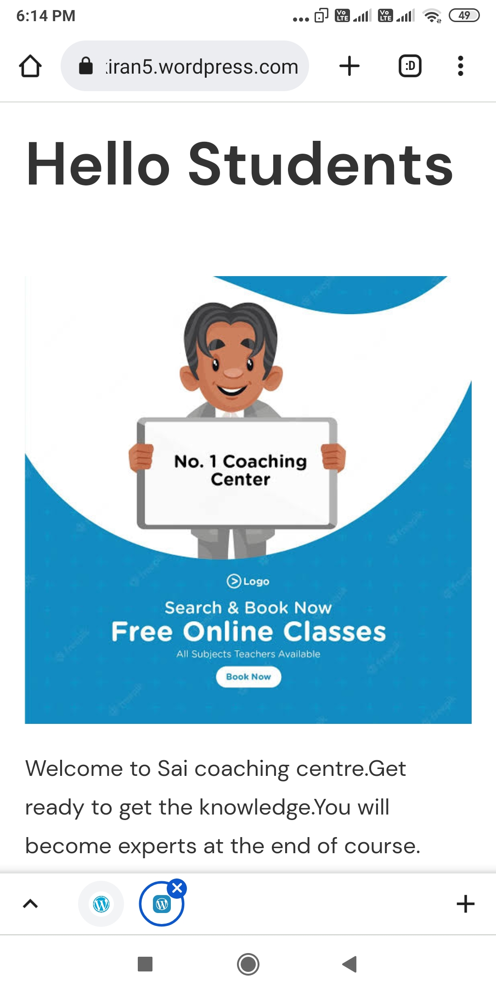
RESULTS
Coaching Website
https://saikiran5.wordpress.com/

Slide 11

MEET OUR TEAM
NAME:BHOGI SAI KIRAN
AICTE EMAIL: bhogisaikiran3@gmail.com
MOBILE NO:8465906985
BRANCH: CSE 3rd year
INTERNSHIP TYPE:CYBER SECURITY
AICTE ID:INTERNSHIP_166004054262f2355ecd0f9
INTERNSHIP ID:STU62f45a256bc981660181029
COLLEGE:NRI INSTITUTE OF TECHNOLOGY,visadala,Guntur,A.P
.

